Slide 1
Predictive Analytics on NYC Motor Collisions
Intermediate Check-in
Anushka Sandesara (anu12@seas.upenn.edu)
Dhruvi Modi (dhruvim@seas.upenn.edu )
Shrivats Agrawal (shriv9@seas.upenn.edu)

Slide 2
Workflow
Data Wrangling and Preprocessing
Web Scraping
Data Visualization
Model Development
In Progress

Slide 3
Web Scraping- Overview
Motivation- We wanted to analyze the data along with the weather of that particular day to better understand the probability of collisions.
We got weather data from year 2012 to 2021 with following columns-
Temperature
Humidity
Wind Speed
Pressure
Precipitation

Slide 4
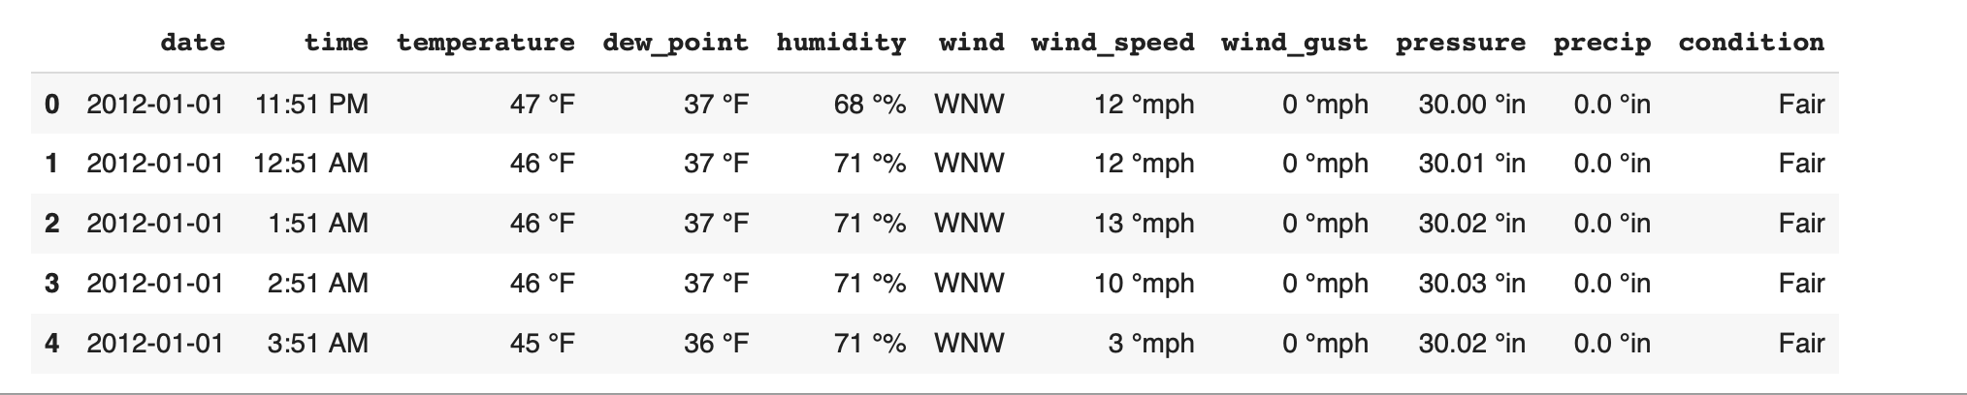
Results

Slide 5
Data Wrangling and Preprocessing-Overview
Motivation- To understand the data more comprehensively we proceeded with this task so we can :-
Convert the raw data into the format that is convenient for performing analysis , visualization and modeling
Check for inaccuracies in data, noisy data, null values which can affect crucial modeling part
We joined weather data with this preprocessed data on datetime of the collision with the corresponding weather data record.

Slide 6
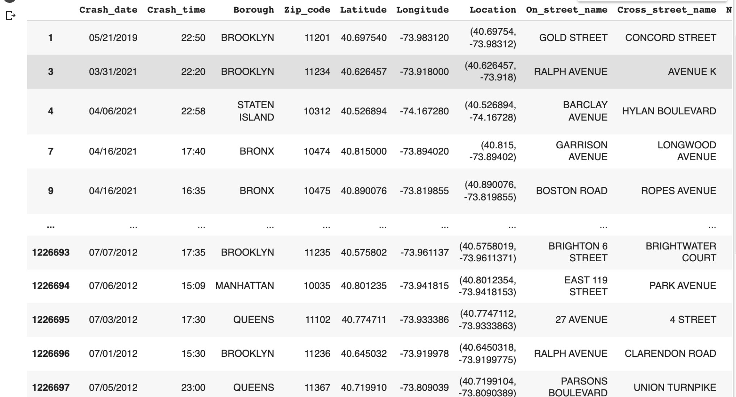
Results

Slide 7
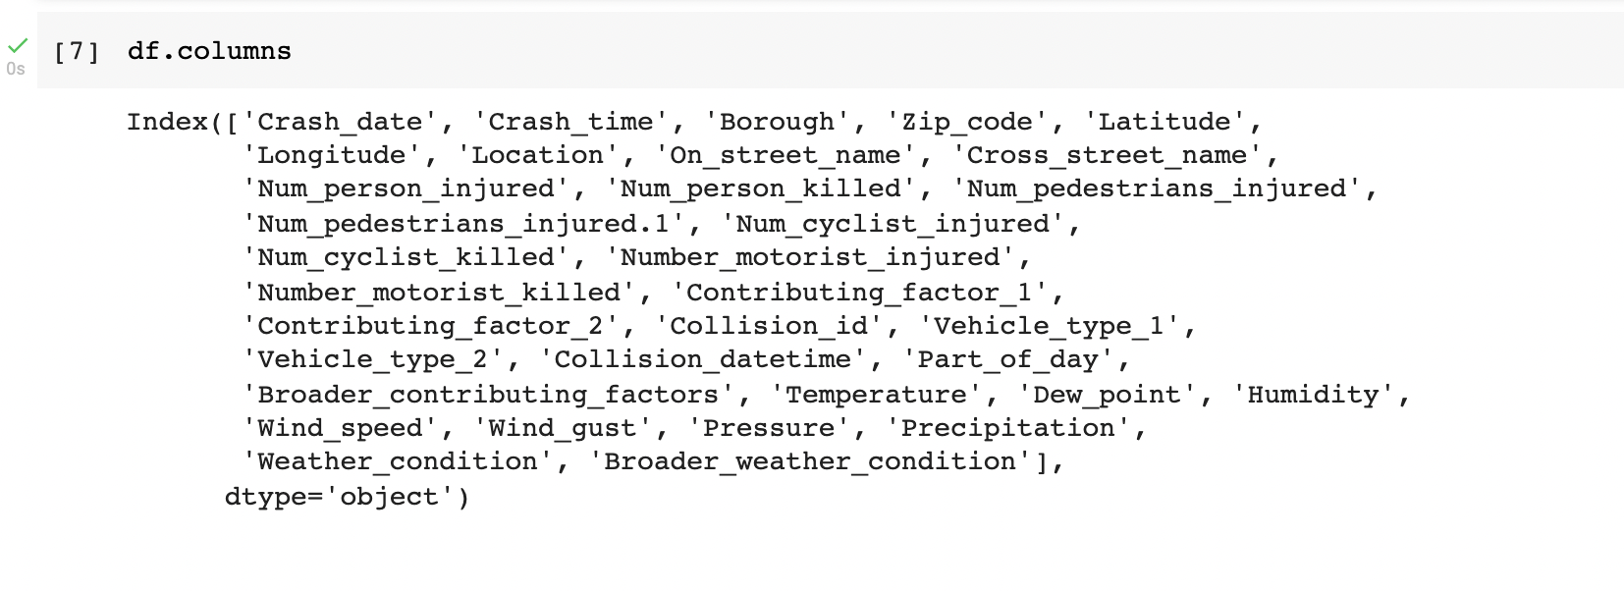
Results

Slide 8
Visualizations- Overview
Motivation- To understand correlations in data, trends over time, frequency distributions and building better models after understanding trends over data
As of now we have implemented
Bar Charts
Pie Charts
Time Series Analysis Plots
Wordcloud
Geopandas map plots
Interactive Folium plots

Slide 9
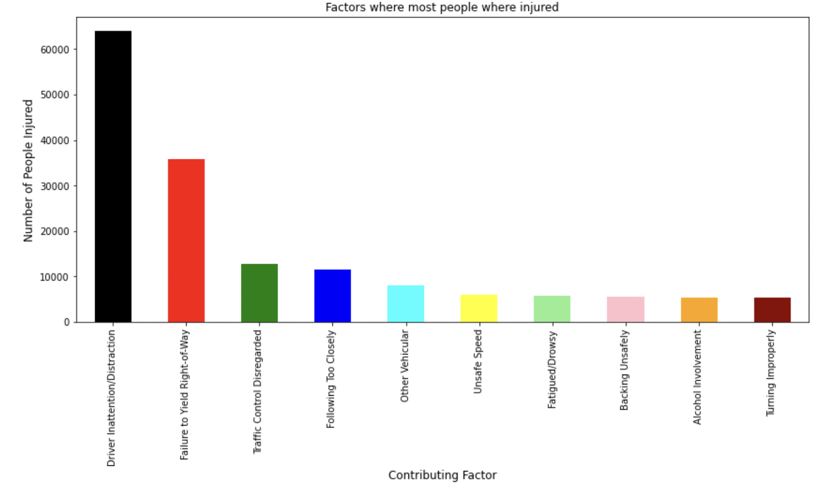
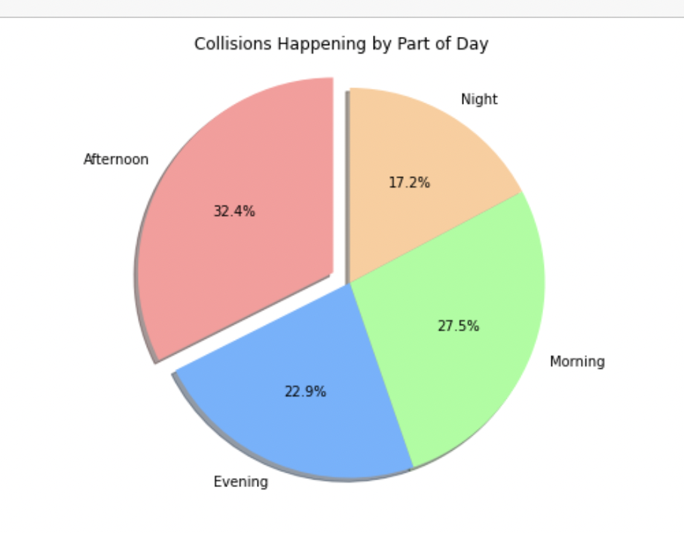
Results

Slide 10
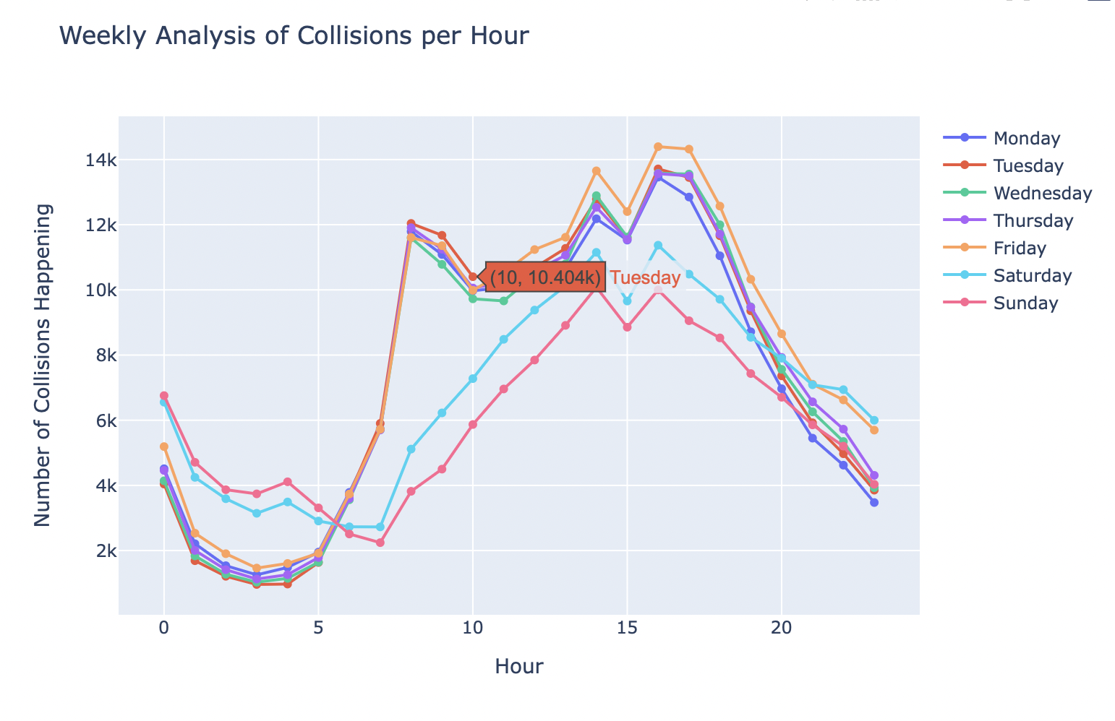
Results

Slide 11
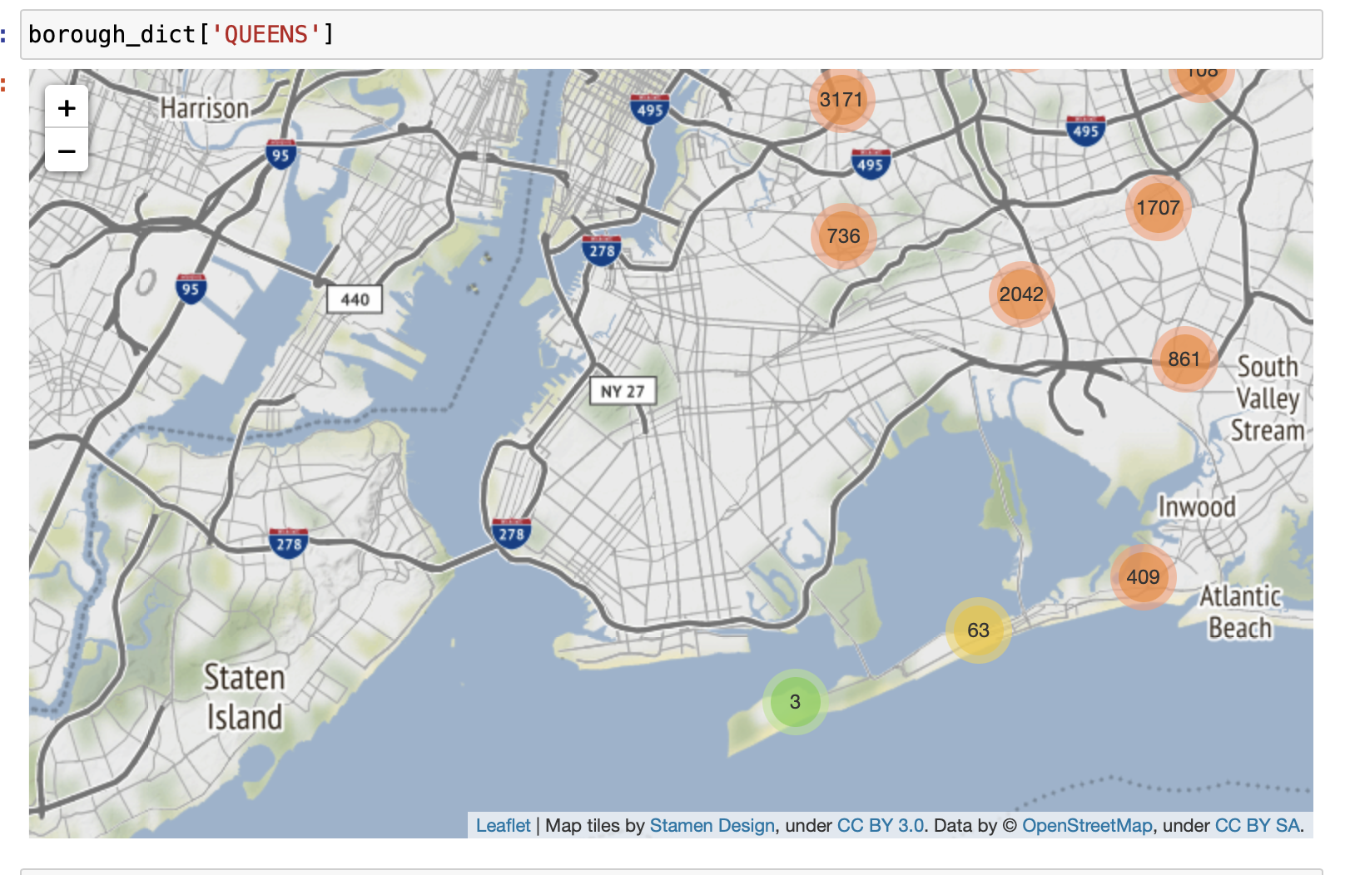
Results

Slide 12
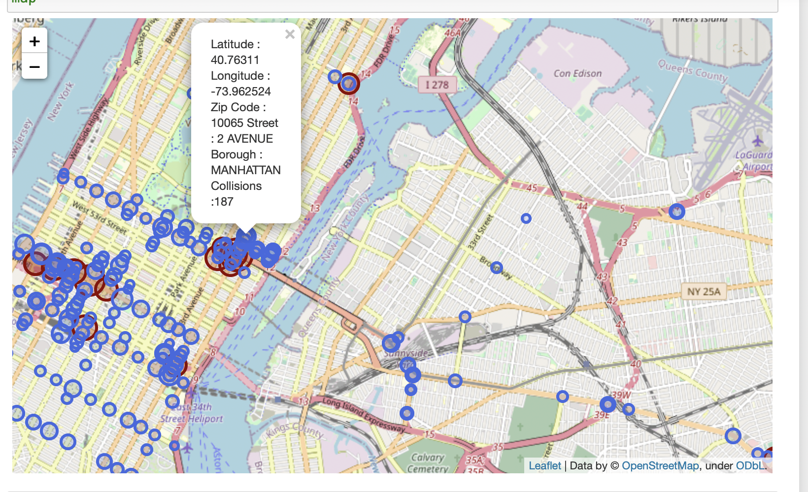
Results

